Slide 1
Our Services
Learn about all the services that the Student Well-Being department offers, offered at no additional cost to all enrolled students!

Slide 2
Student Well-Being provides counseling services, health promotion initiatives, and prevention programs to empower the S&T community to thrive and enhance personal, academic, and professional success.

Slide 3
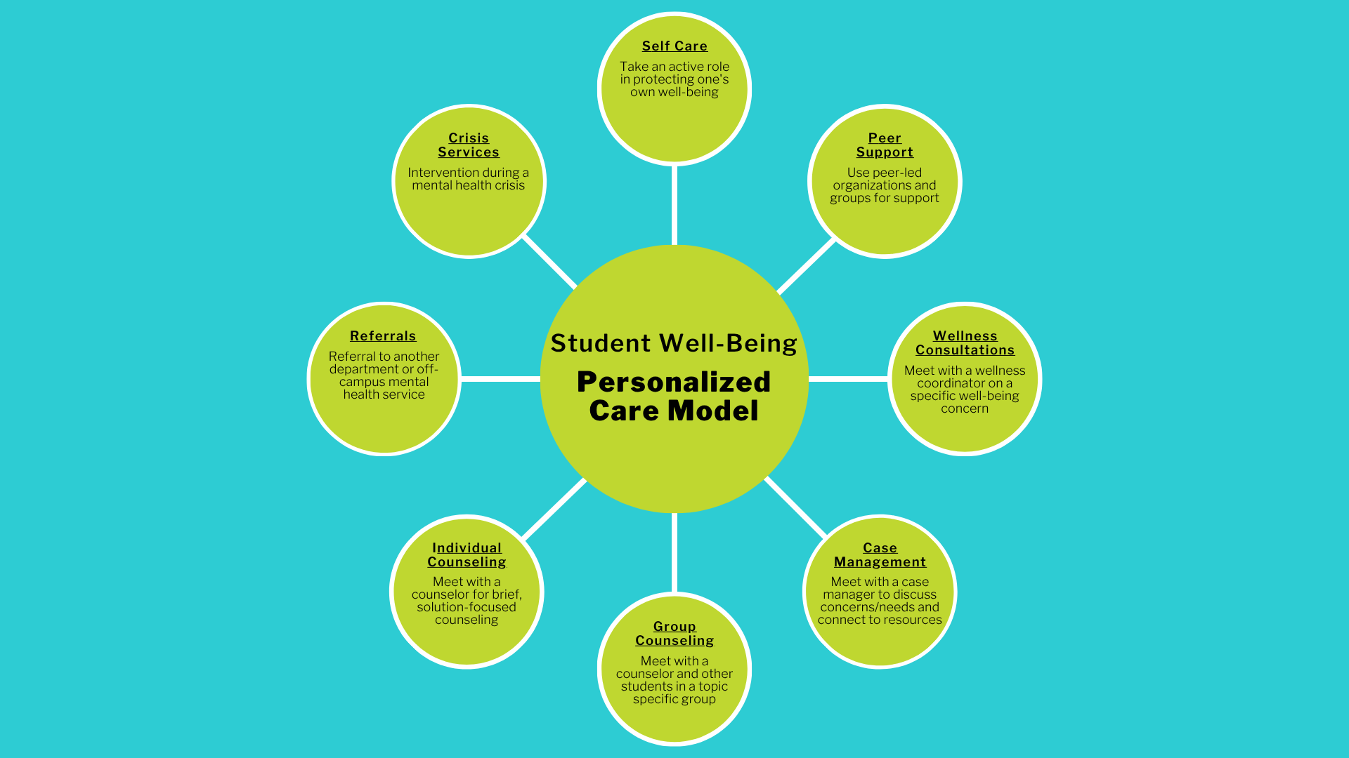
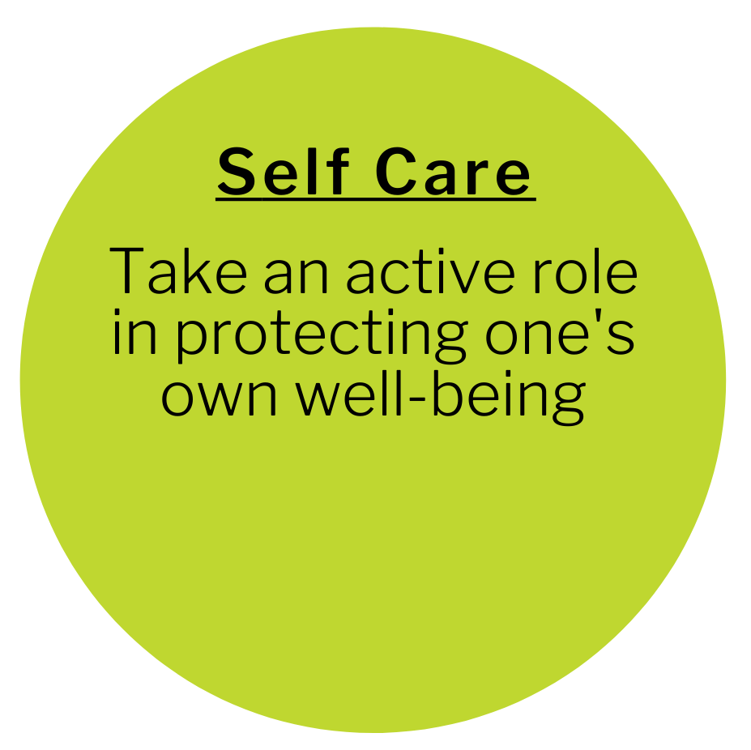
Notes:
When first meeting with our office you will complete a screening with a staff member. During the screening, the staff member will ask you a short list of questions. They will then walk you through the Personalized Care Model, a visual way to help determine what support type is best for you based on your individual needs. You can schedule a screening on our website (wellbeing.mst.edu) or call 573.341.4211
The Student Well-Being Personalized Care Model is essentially a visual representation to help you, the student find support, resources, and services based on your mental health and well-being needs.

Slide 4
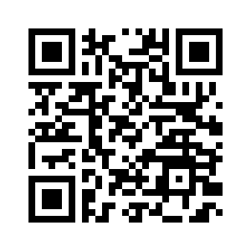
Overview of Our Services
Counseling
Case management
Wellness consultations
Programming and online course
Bystander intervention
Student-led groups
Miner Oasis
Notes:
All services and resources provided by Student Well-Being are free to all enrolled students.

Slide 5
Counseling
Confidential, licensed counselors available for all students
Individual counseling
Group counseling
Crisis services
Community referrals and resource referrals
Notes:
Note that counseling services are provided by non-mandated reporters and adheres to HIPAA regulations (similar to student health or other healthcare providers)
We have 6 counselors on staff and all Student Well-Being counselors are at least Masters level educated and are fully licensed as either a Licensed Professional Counselor (LPC), Licensed Social Worker (LSW), or a Licenses Master Social Worker (LMSW) in the state of Missouri. The only exception to this is if there is an on-staff Practicum Student, who is Bachelors level educated and is working on completing their Masters degree. Counseling staff follow all state and federal counseling/ therapeutic laws and regulations.
Are there session limits? No. We offer brief, solution focused counseling and the number of sessions is determined by the counselor (on average, students engage in 3-4 sessions). Participation in groups of any amount and frequency is not limited.
We offer over ten group counseling on a variety of topics.

Slide 6
Wellness Consultations
These are sessions provided by health educators in a short-term format
Some topics include:
  Nutrition
  Alcohol use
  Cannabis/marijuana use
  Bystander intervention
  Sleep
  Safe space
  Self regulation
  Nicotine cessation
  General wellness/other
Notes:
Wellness consultations are customized, private sessions with a wellness coordinator on a specific well-being concern. Some topics we currently cover are alcohol use, cannabis use, nicotine cessation, substance use, nutrition, sleep, general wellness, and more! Consultations typically last 45 minutes to an hour, and are meant to fit within your busy schedule
*Note that wellness consultations are provided by mandated reporters

Slide 7
Case Management
Work with students to address immediate needs, connect to appropriate resources, and navigate barriers to their success
Resource connection and referral
Coordination of care
Emergency funding
UCARE support
And more, based on your specific needs!
Notes:
Case management is a great service in our department that really acts as a catch all to your health and well-being needs. A case manager can connect you to resources, help you with any absences or leaves, coordinate your care among other departments, help you apply for emergency funding sources, and a lot more! If you are struggling or need help and aren’t sure how to proceed, this is a great first step!
*Note that care managers are provided by mandated reporters

Slide 8
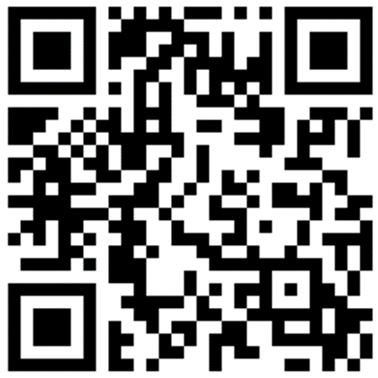
UCARE
Central point of contact and referral for students who may be experiencing a personal, academic, financial, wellbeing, or other concern
Submitting a referral allows for trained staff to connect with students in need to offer support and resources
Notes:
Our case managers also work with students through UCARE, the central point of contact and referral for students on campus who might be experiencing a personal, academic, financial, well-being, or other concern! Through UCARE referrals, a case manager can reach out to a student in need before a situation escalates and provide resources, support, and more. You can learn more about the process and submit a referral using the qr code or at ucare.mst.edu.

Slide 9
Presentations and Programming
Presentations, outreach events, and trainings for groups, departments, organizations, and community members
Some topics offered:
  Bystander intervention
  Nutrition/ healthy eating
  Healthy coping skills
  Resource awareness
  Stress/ time management
  Resilience, motivation, and self care
Notes:
Student Well-Being provides presentations, trainings, and workshops to organizations, classes, and other groups that request them. Requests can also be made for department presence, such as for a discussion panel, event, meeting, etc. A request for department presence does not have to be directly related to a pre-made presentation.
All requests must be made at least two weeks in advance. Special, tailor-made requests must be done one month in advance.
Depending on the presentation requested, we may schedule a consultation with you to tailor the presentation to your group's goals.

Slide 10
Bystander Intervention
Our STEP UP! for Bystander Intervention program helps students and staff recognize problematic events and increases their motivation and skills to help. Current trainings offered:
  Mental Well-Being
  Bias and Discrimination Prevention
  Interpersonal Violence Prevention
  Alcohol and Other Drugs
  General Bystander Intervention
Notes:
STEP UP! empowers the campus community to foster a culture of awareness, intervention, and inclusion in all our interactions in person, on social media, and virtually.

Slide 11
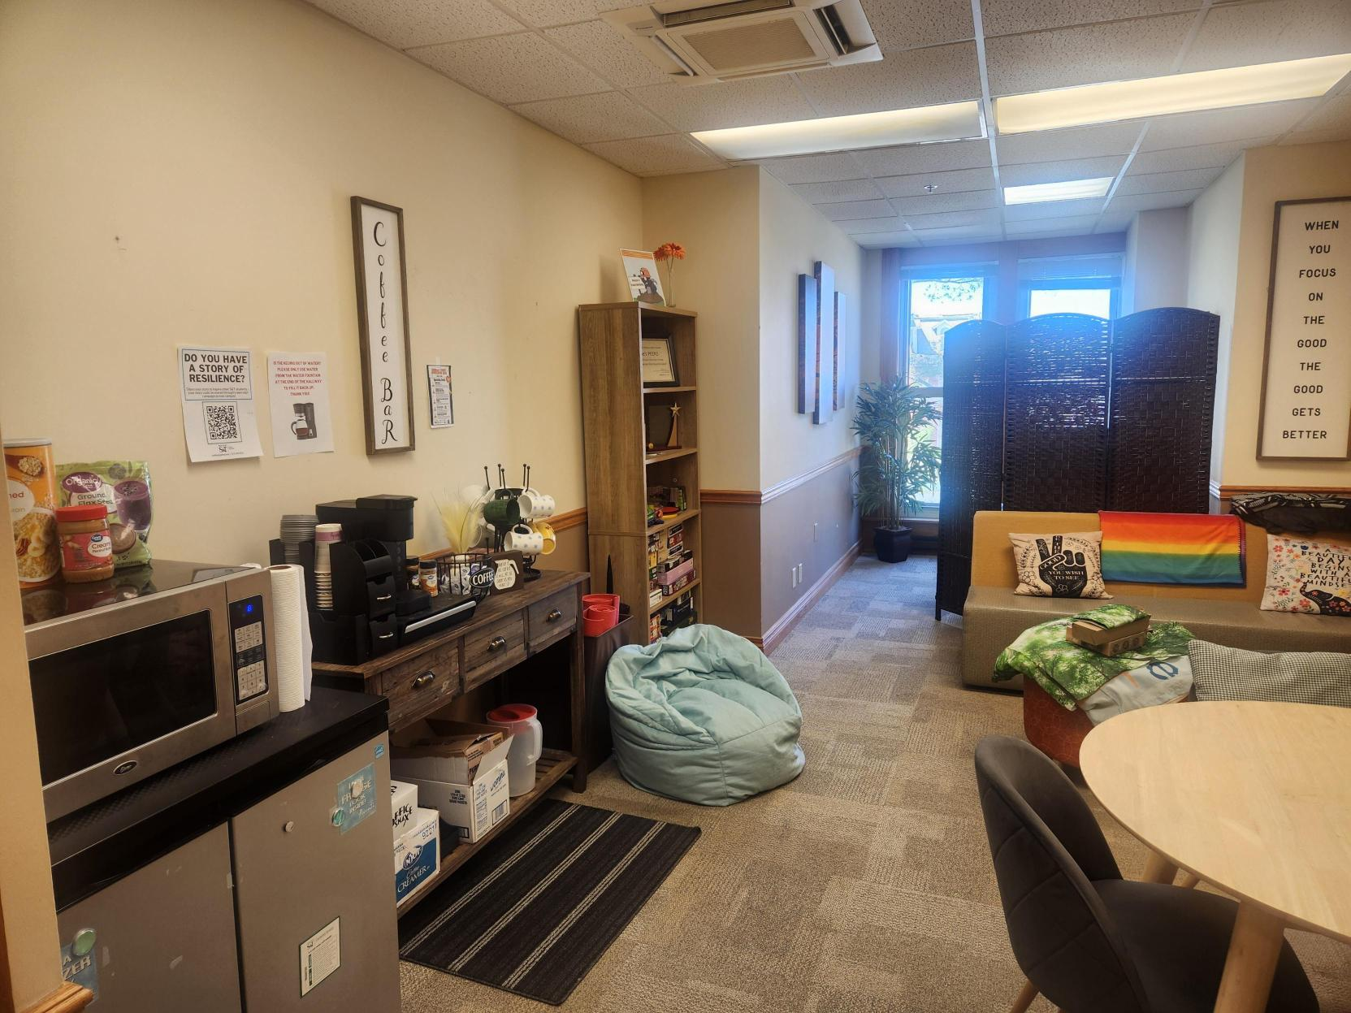
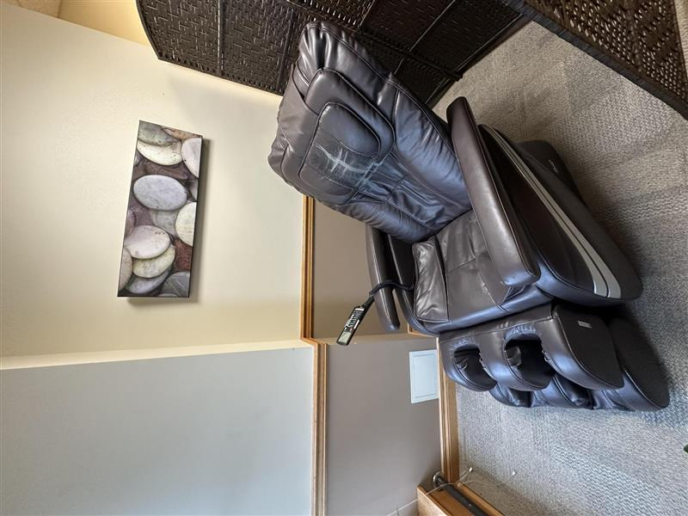
Miner Oasis – 202 Norwood Hall
Notes:
The Miner Oasis is simply a place to relax.
We have coloring books, customizable essential oils, coffee and tea, yoga mats, and a massage chair to help you de-stress and be your best self!
The Miner Oasis is open Monday - Friday, 8am - 4:30pm, in 202 Norwood Hall

Slide 12
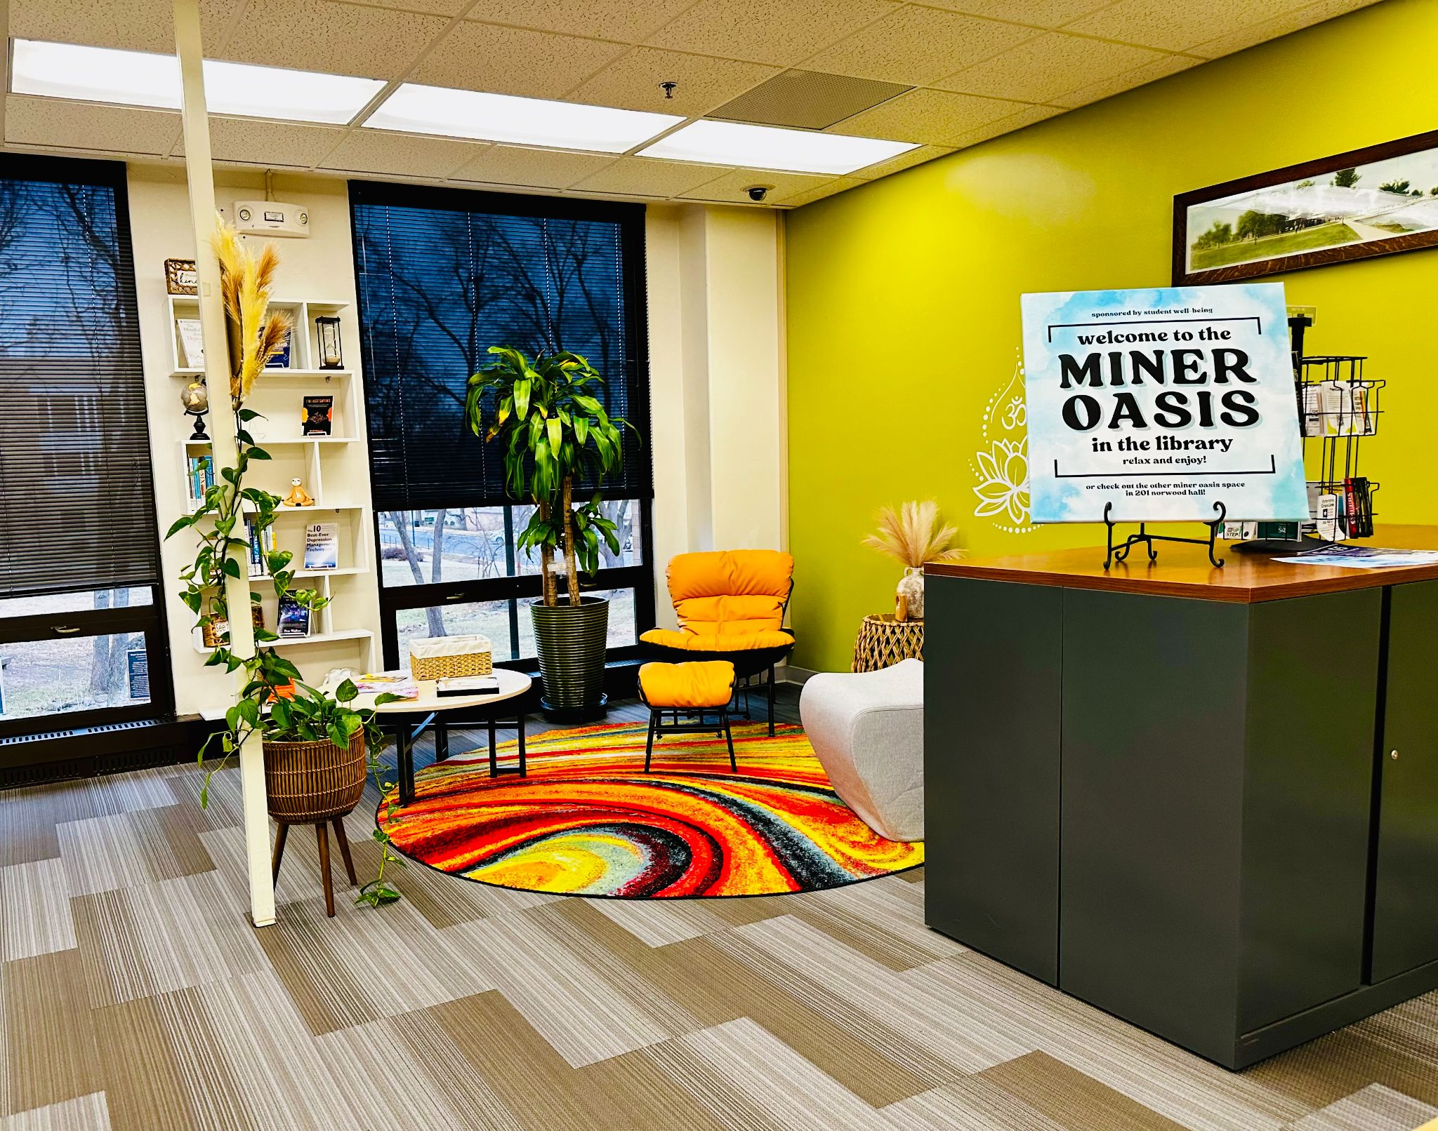
Miner Oasis - Library
Notes:
There is also a Miner Oasis on campus you can enjoy! Check out this space in the Library. There is also an oasis space in the Innovation Lab, both open during that building’s hours.

Slide 13
Joe's PEERS
Student-led leadership organization that provides education, encouragement, and resources to students and campus community members through events, programming, and more!
Meetings are held every Monday at 12pm throughout the semester- join at any time!
Notes:
JOE’S PEERS is a student leadership organization that promotes health and wellness by providing education,encouragement, and resources to Missouri S&T students.
Joe’s PEERS members will develop experience in public speaking, interpersonal communication, self-management, teamwork, and act as resource persons to the campus community.
It is open to both undergraduate and graduate students.

Slide 14
Online Resources
Miner Well-Being Certification Program
Health and Well-Being Canvas Course
Complete a series of activities focused on different areas of well-being
Build a well-rounded and holistic look at wellbeing
Housed in MinerLink
Trainings, videos, and more covering a variety of health and wellness topics
Non-credit, enroll anytime
Housed in Canvas under "ROLLA – Health and Well-Being"
Notes:
Read from slide

Slide 15
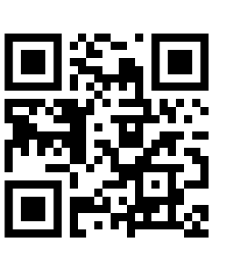
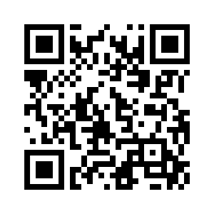
Online Resources Continued
Resource Directory
Apps and Digital Tools

Slide 16
24/7 Resources
Always call 911 in an emergency
National Suicide and Crisis Lifeline
  Call or text 988
Compass Health Hotline
  833.356.2427
Phelps Health
  573.458.8899

Slide 17
Notes:
BetterYou is a healthy habits companion app that is free for S&T students! Earn your first of many rewards after completing onboarding in the app and get a $5 gift card to a retailer of your choice!
With BetterYou, you can set a goal to get more sleep, hit a few more steps, keep in touch with loved ones, or meditate for a few more minutes this semester. Your mind and body will appreciate it. And your wallet will appreciated it- working toward and completing your goals allow you to get multiple $5 rewards to be used at hundreds of your favorite places, such as Starbucks, Dominos, Amazon, Apple, Applebees, over 200+ retailers, and so many more.
*Note: Using your @mst.edu email is required as this is what allows for access to the app.

Slide 18
Notes:
Student life can be a lot sometimes. Download the TalkCampus app to connect anonymously with other students who understand what you're going through. You can post how you’re feeling, chat with others, journal, and more! Sign up for free with your student email address by scanning the qr code. Everything you do on the platform is anonymous, and using your student email just verifies that you are in fact a student, ensuring no staff, family, or community members can get access!

Slide 19
Thank you!

